Slide 1
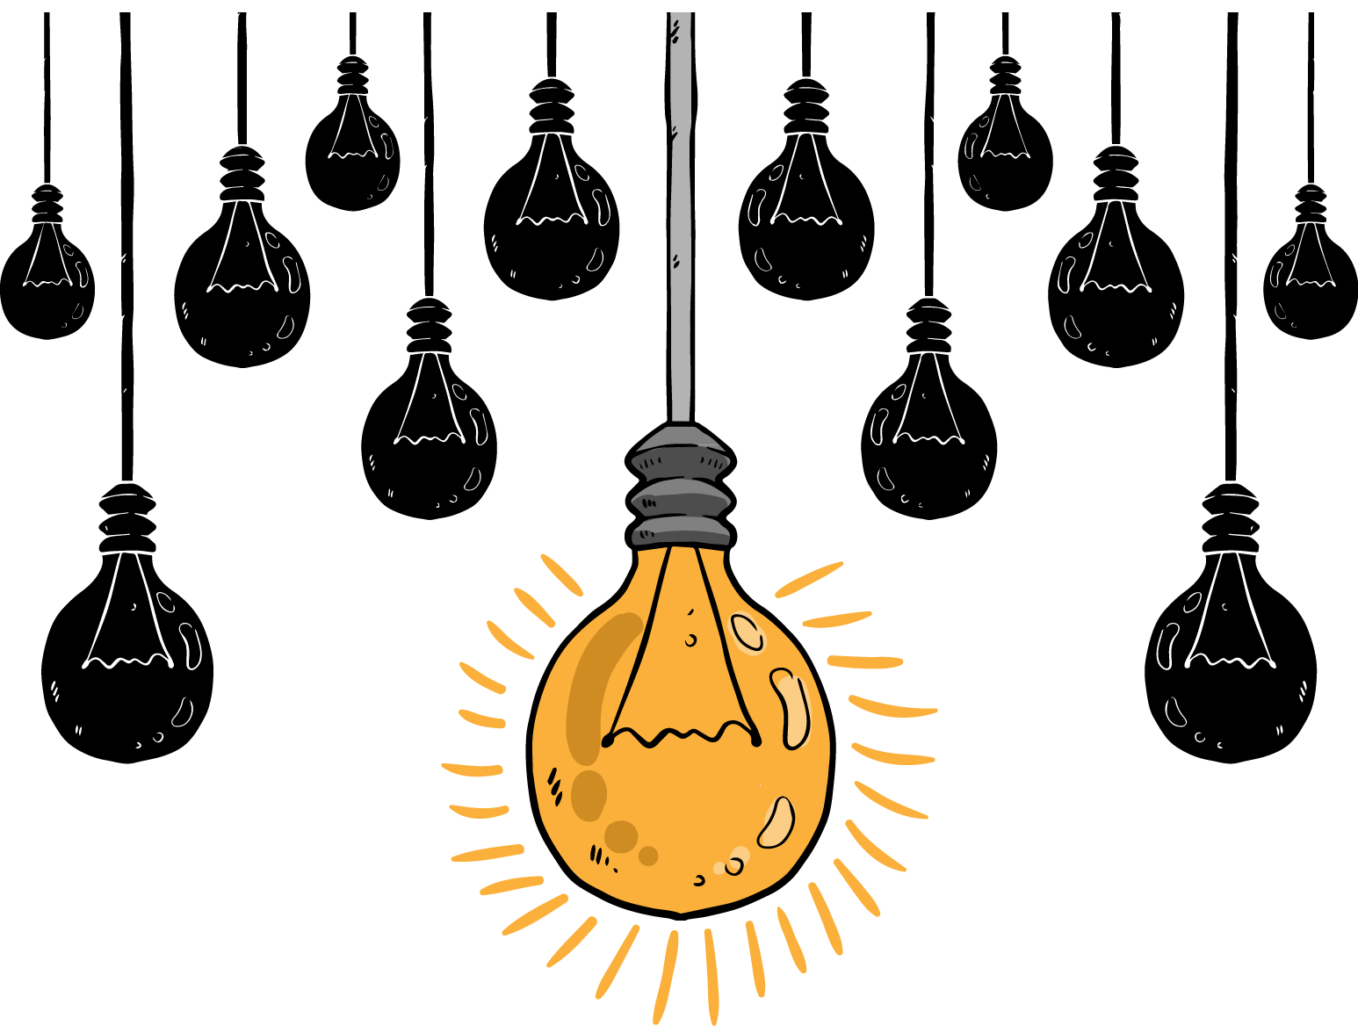
Artificial Neural Network
Wangjun SHEN
The University of South Australia
Notes:
Good morning, everyone. Welcome to join my presentation.
My name is Wangjun SHEN, and today, I will be speaking on the topic of Artificial Neural Networks.

Slide 2

Content Table
1. AI → ANN
2. History of ANN
3. ANN Model
4. Applications
Notes:
In today's presentation, we will first explore the relationship between AI and ANN. Following that, we will provide a brief overview of the history of ANN. Next, we will delve into some technical aspects of ANN models. Finally, we will discuss various applications of ANN models.

Slide 3
THE ONE
AI and ANN
Notes:
So, let's start by discussing AI.

Slide 4
What is AI?
4 types of definitions
Human Behaviour
Rational Behaviour
Thinking Humanly
Thinking Rationally
Thinking
Acting Humanly
Acting Rationally
Action
Notes:
We often talk about AI, but what is AI?
AI can be defined using two key indicators: "Thinking/Action" and "Humanly/Rationally."
From these indicators, we can derive four definitions of AI, which are: "Thinking Humanly," "Thinking Rationally," "Acting Humanly," and "Acting Rationally."

Slide 5
Three major schools
Symbolic AI
- Symbols
- The Process of Symbolic Manipulation
- Expert system
1
Probabilistic AI
- Probability + Statistics
- Bayesian network, Markov decision
- Decision support, automatic planning
2
Connectionism
- Biological nervous system
- Neural Networks and Learning Algorithms
- Image recognition, natural language processing
3
Notes:
Based on these four different definitions of AI, research in AI has evolved into three different schools of thought.
The Symbolism school of thought in AI represented knowledge using formal symbols and employed logical rules for computer programs. While it had success in areas like expert systems, it struggled with uncertainty and handling extensive data.
The Probabilistic AI school focuses on using probability and statistics to address uncertainty. It utilizes methods like Bayesian networks and Markov decision processes, commonly applied in decision support, pattern recognition, and automated planning, improving AI's ability to handle real-world uncertainty and noise.
Connectionism centers on neural networks and learning algorithms, inspired by biological neural systems. Deep learning, a subfield of connectionism, has achieved remarkable progress in tasks such as image recognition and natural language processing, thanks to deep neural networks processing vast datasets.

Slide 6
What is ANN?
Inspired by biological nervous systems
subset of artificial intelligence
The core of connectionism
Simulating how the human brain works
Notes:
So we can know ANN is the key part of Connectionism in AI. They're inspired by the human brain, consisting of interconnected artificial neurons for learning and various tasks. ANNs emulate human information processing, crucial for machine learning and AI in tasks like perception, decision-making, and problem-solving.

Slide 7
THE TWO
History of ANN
Notes:
Let's continue by taking a look at the historical development of Artificial Neural Networks (ANN).

Slide 8
The history of ANN
A mathematical model simulating neurons was proposed
1943
Start
Simple neural network model → binary classification task.
1957
Develop
XOR is a nonlinear separable problem that cannot be solved by traditional perceptrons
1960s
Dilemma
Back propagation algorithm
Allows neural networks to learn complex non-linear functions
1980s
Progress
From 1990s
Revival
More powerful computing power
Availability of large-scale data sets
Notes:
In 1943, the mathematical model of neurons was not proposed, but it was not until 1957 that the perceptron model was created.
The Perceptron model is a simple binary neural network model, so this causes the XOR problem to become a difficult problem to solve.
Due to the inability to solve the XOR problem, ANN activity began to decrease until the Back Propagation algorithm was proposed in the 1980s, allowing the neural network to learn more complex functions.
From the 1990s to the present, due to the availability of big data and more powerful computing, ANN research has become popular and many applications have been developed.

Slide 9
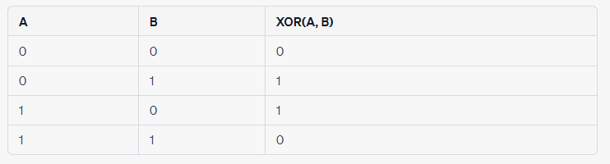
XOR Problem
Math Function:
Function A XOR B = (A AND (NOT B)) OR ((NOT A) AND B)
Language Describe:
- If the two input binary values are the same, the result is 0.
- If the two input binary values are different, the result is 1.
Notes:
Let me briefly explain what the XOR problem is.
The XOR problem is a classic logic problem that represents a logical operation with two binary inputs and one binary output.
The rule of XOR (exclusive OR) operation is as follows:
- If the two binary values of the input are the same, the result is 0.
- If the two binary values of the input are different, the result is 1.
The difficulty of the XOR problem lies in the fact that it is not linearly separable. This means that you cannot use a single linear decision boundary to cleanly separate the two different output categories. This presented a challenge for early neural network models like the perceptron because perceptrons could only handle linearly separable problems and could not solve the XOR problem.

Slide 10
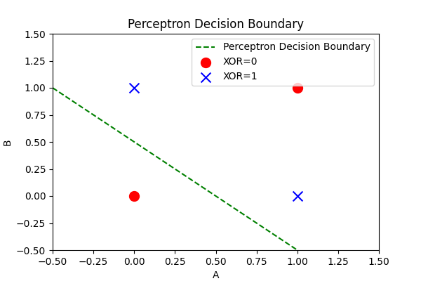
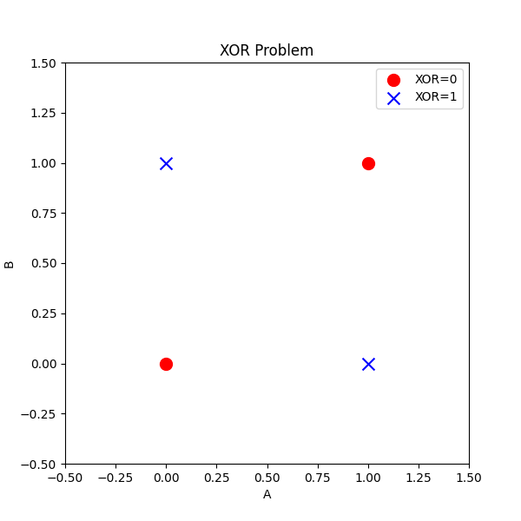
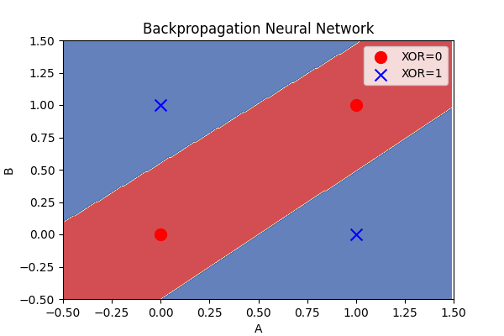
XOR Problem Visualization
Notes:
We can show it using code.
First we generate this XOR data, and then we can visualize it. This is the result of the visualization.
Then we tried to use a traditional perceptron and visualized the results. We found that the model could not classify the two well.
But if we use neural models that use the backpropagation algorithm, the result will become like this. It can be found that the model can already distinguish the data very well.

Slide 11
THE THREE
ANN Models
Notes:
Next, let us discuss the ANN model in detail.

Slide 12
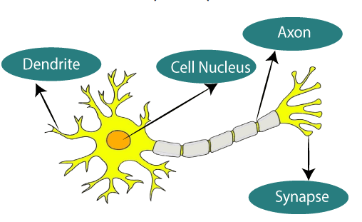
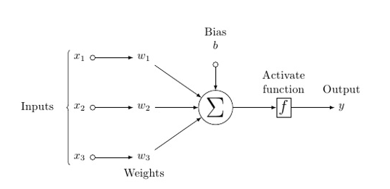
The smallest unit of ANN - An Artificial Neuron
Input: input signal received by the neuron
Weights: Adjust the influence
Weighted Sum: the combined influence of a neuron on the input
Bias: An additional input, adjusting a neuron's overall response to input helps change the neuron's flexibility
Activation Function: The number takes the result of a weighted sum and offset and applies some kind of nonlinear function transformation.
Output: The output of the activation function is used as the final output of the neuron
Notes:
An artificial neuron, the fundamental unit of a neural network, comprises an input that receives external data, weights to adjust input importance, a weighted summation combining inputs and weights, an added bias for flexibility, and an activation function applying a non-linear transformation to enable learning complex patterns. Its output, derived from this process, serves as the result or input for subsequent neurons, allowing them to process and learn from data, forming the basis for intricate neural network models.

Slide 13
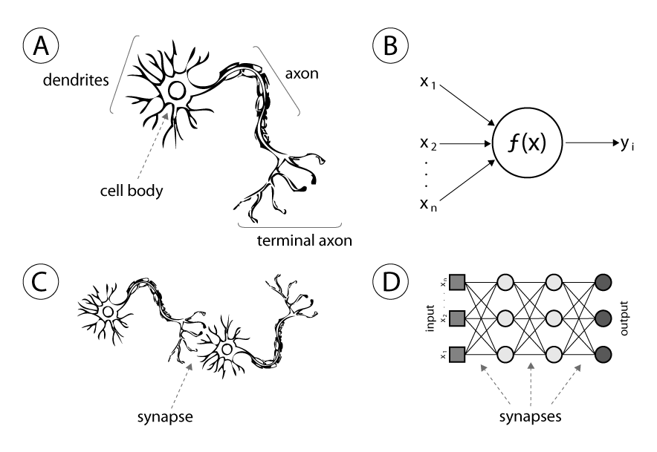
From Neuron Cell to the Simplest Network
Simplest Netowowk
Input_01
↓
Cell_01
↓
Output_01
↓
Input_02
↓
Cell_02
↓
Output_02
(Result)
Notes:
After discussing neurons, it's important to delve into the concept of neural networks.
A single neuron cannot be considered as a network; a minimum of two neurons is required to form the simplest network.
Part C of the diagram illustrates the structure of the most basic neural network, consisting of two neurons. The first neuron receives data, processes it, and produces an output, which is then passed as input to the second neuron. The second neuron processes this input to generate the final output.
In reality, networks can become much more complex, as shown in Part D of the diagram. A neural network can comprise multiple layers and numerous interconnected neurons, creating a powerful tool for processing and learning from data, and solving a wide range of complex problems.

Slide 14
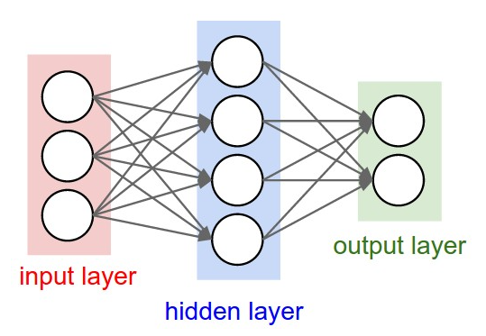
The Structure of the Network
Input Layer:
- receive data,
- do not process calculations and process data
Hidden Layer:
- does not communicate directly with the outside world
- perform complex calculations and feature extraction
Output Layer:
- produces the final output of the neural network
Notes:
This is a visualization of a more complex neural network.
Neural networks are graphically represented as neurons connected in a directed acyclic graph (DAG), where the output of one neuron serves as the input for the next neuron. In the neural network structure, cycles are not allowed to prevent infinite loops during forward propagation. Neurons are organized hierarchically into layers.
1. **Input Layer**: The input layer is the first layer of the neural network, responsible for receiving input data. Each input neuron corresponds to a dimension of the input features. In this example, there are three input neurons, indicating that the input data has three dimensions. The input layer typically performs no computation and only passes the data to the next layer.
2. **Hidden Layers**: These intermediate layers in the neural network do not directly communicate with the external world. Neurons in the hidden layers perform complex computations and feature extraction.
3. **Output Layer**: The output layer generates the final output of the neural network, typically representing the solution to a specific problem. The number of neurons in the output layer depends on the nature of the task. For instance, a binary classification problem might have one neuron, while a multi-class classification problem could have multiple neurons.

Slide 15
Forward Propagation and Backpropagation
Backpropagation
Compute the output of forward pass
↓
Calculate losses
↓
Back propagation error signal
↓
Update the parameters of the neural network
↓
Forward Propagation
Forward Propagation
Input Data
↓
Input Layer
↓
Hidden Layers
↓
Output Layers
↓
Final Result

Slide 16
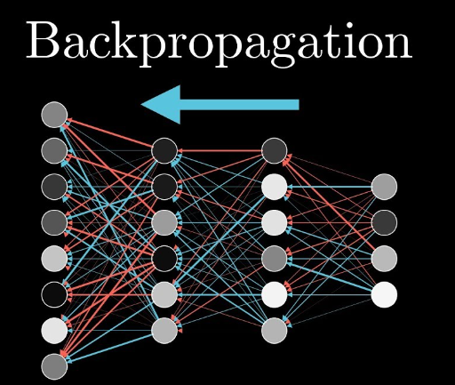
Backpropagation
Compute the output of forward pass
↓
Calculate losses
↓
Back propagation error signal
↓
Update the parameters of the neural network
↓
Forward Propagation

Slide 17
THE FOUR
Applications of ANN
Notes:
After we understanding how the ANN Model works, we can talk about some applications which are built by ANN.

Slide 18
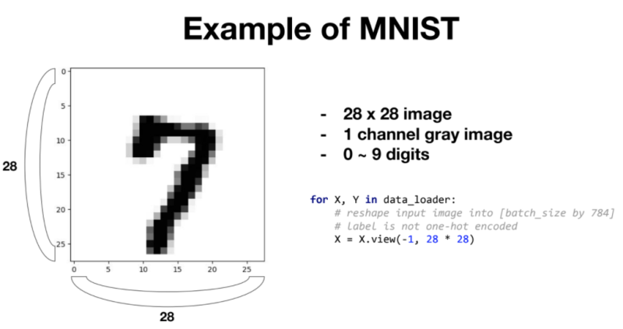
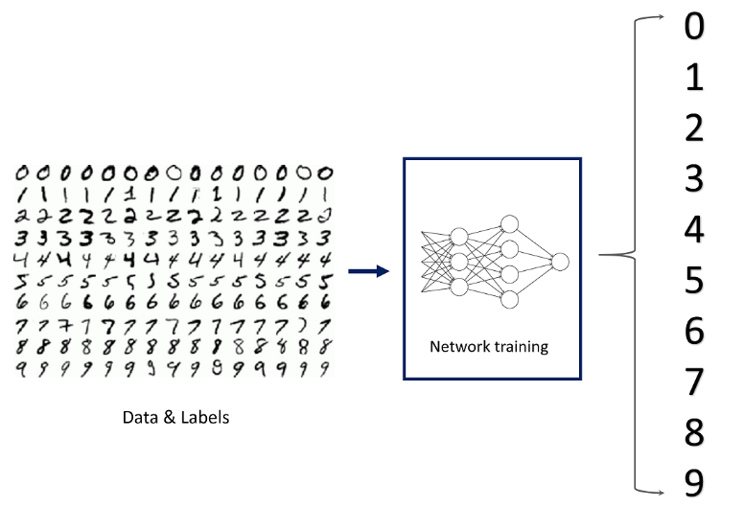
Computer Vision - Digital Recognition
MNIST → Training am ANN Model → Using the Model to Identify Numbers
Github: https://github.com/YeJiu97/master-of-data-science-unisa/tree/main/03-AdvancedAnalyticTechniquesI/Project/own_ann
Notes:
The first application area of Artificial Neural Networks (ANN) is in the field of computer vision. ANNs have the ability to recognize the content of input images, allowing for object classification and identification.
To illustrate this capability, we can use the MNIST dataset to demonstrate how neural networks can successfully recognize digits.
The MNIST dataset comprises handwritten digit images, covering all digits from 0 to 9. Each image is a grayscale image with dimensions of 28x28 pixels. Through training, a neural network can learn to recognize similar inputs and classify them into their corresponding digits.
This is the model I've trained. We can do a simple test to show whether that model can recognize a number on a picture.
You can find the code for this model on my GitHub repository. However, we won't go into specific details here.

Slide 19

Computer Vision – Complex System
Identify Objects → Classify → Perform Operations
Notes:
If ANNs can recognize the content of input images, they can indeed classify and perform more complex tasks on that recognized content.
For example, consider the image recognition system in an autonomous vehicle's driving system, as shown in the figure.
Similarly, there are various other applications in fields such as medicine, where X-ray systems can use image recognition for diagnosis, and in security, where facial recognition systems are employed, among many others.
The ability of ANNs to understand and classify visual data has paved the way for numerous applications across different industries, enhancing automation and decision-making processes.

Slide 20
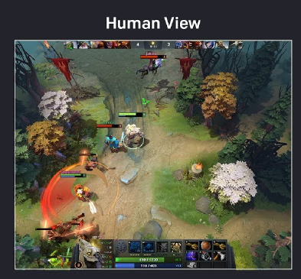
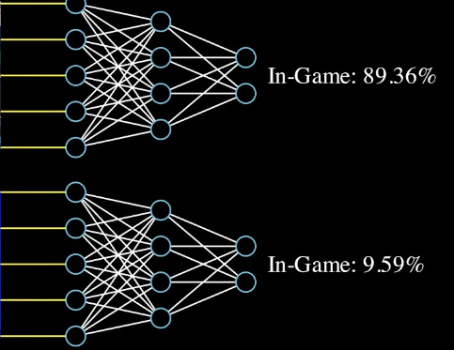
Game AI – Dota AI
AI defeated the human champion team with a score of 2:0
Notes:
Using ANN models, AI is no longer restricted to processing games represented with symbols as output but can handle image-based games.
In 2018, OpenAI trained an AI that could play Dota 2 and defeated the human champion team with a score of 2:0. This achievement marked a significant milestone in AI's ability to handle complex, real-time strategy games with rich visual content and dynamic gameplay.
The application of ANNs in gaming has opened up new possibilities for creating AI agents capable of mastering a wide range of games and challenges, often surpassing human performance in the process.

Slide 21
Natural Language
Natural Language Processing
Translation System
Other Applications
Recommendation systems
………………………………..
Notes:
In addition to visual applications, ANNs have made significant advancements in the field of text processing.
Here are some commonly used applications in this domain, including Natural Language Processing, translation systems, recommendation systems, and similar systems.
These applications have revolutionized the way we interact with and process textual data, enabling more efficient and effective communication, information retrieval, and content recommendation. Thank you for your attention.

Slide 22
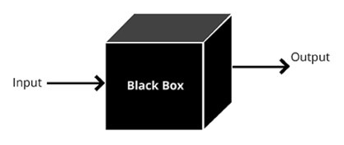
Black Box
- There are a lot of input features
- The input data is high-dimensional data
- There are many layers
- There are countless nodes
- Backpropagation will repeatedly debug the parameters of each node
Notes:
Artificial Neural Networks (ANNs) have advanced significantly, but they pose a challenge due to their "black-box" nature. ANNs process complex, high-dimensional data through layers of neurons, making it nearly impossible to fully interpret their internal workings. Training involves adjusting countless parameters, making it difficult to track the model's decision process. Despite this limitation, ongoing research aims to make ANNs more interpretable, crucial for applications requiring transparent model decisions, such as medicine and law.

Slide 23
Thank you
Everyone
Notes:
That's all we need to know about ANN.
Thank you very much for listening to my speech.
Thank you.

Slide 24
Thorn, J. (2020). Deep Learning for NLP: ANNs, RNNs and LSTMs explained! [online] Medium. Available at: https://towardsdatascience.com/deep-learning-for-nlp-anns-rnns-and-lstms-explained-95866c1db2e4.
‌www.sciencedirect.com. (n.d.). Artificial Neural Network - an overview | ScienceDirect Topics. [online] Available at: https://www.sciencedirect.com/topics/earth-and-planetary-sciences/artificial-neural-network.

